Slide 1

Deliverable 3
———
Consultant: Izaz Ahmad
Stakeholder: Ned Hulseman

Slide 2
Machine Learning Approach - 1
Goal: To create a successful recommendation system based on user behavior, the goal is to cluster users based on similar features and recommend tailored content to these groups.
Approach:
Used unsupervised learning, which is used for data without labels.
Tested K-Prototype Clustering, a clustering method that involves both categorical and numerical data, to group users. However this method was not as effective as K-Modes clustering.
Tested and applied K-Modes clustering, a clustering method specifically designed for categorical data. K-Modes had better results since most of the useful data in the Netflix dataset is categorical.

Slide 3
Machine Learning Approach - 2
Steps Taken:
Decided which features to use in the recommendation system.
Prepared data by cleaning, formatting, and also fitting data to apply clustering methods.
Used Elbow methods to determine the optimal number of clusters.
Applied the Clustering method. (K-Modes and K-Prototypes)
Compared both clustering methods and decided on which one is better and used that for the recommendation system. (K-Modes had better results)

Slide 4
K-Modes Clustering
Steps:
Data Preparation: Cleaned data and dropped numerical columns as well as columns that were not significant. The main features were Subscription Type, Device Type, and Country.
Clustering:
Transformed categorical data to be used for clustering.
Used elbow method to determine optimal cluster number.
Performed K-Modes clustering.
Analyzing: Analyzed clusters, for example device types were grouped into different clusters.
Although K-Modes only clusters categorical data, this was not a problem since most of the significant data was categorical. The only significant numerical feature was Age, but even that was not an issue since the Age data had a uniform distribution so clustering it would not have significantly impacted the Recommendation system.

Slide 5
Results of K-Modes Clustering - 1
The optimal number of clusters was 4 (starting from 0 to 3).
Clusters:
Cluster 0: Mostly Laptop users from North America (majority from US), that had a Basic subscription.
Cluster 1: Mostly Tablet users from Europe and South America (majority from Spain and Mexico) that had a Standard subscription.
Cluster 2: Mostly Smart TV and Smartphone users from North America (majority from Canada), that had a Premium subscription.
Cluster 3: Mostly Smartphone users from Europe (Spain, Germany, and Italy), that had a Basic subscription.
These clusters separated users based on features that will be used to recommend personalized content.

Slide 6
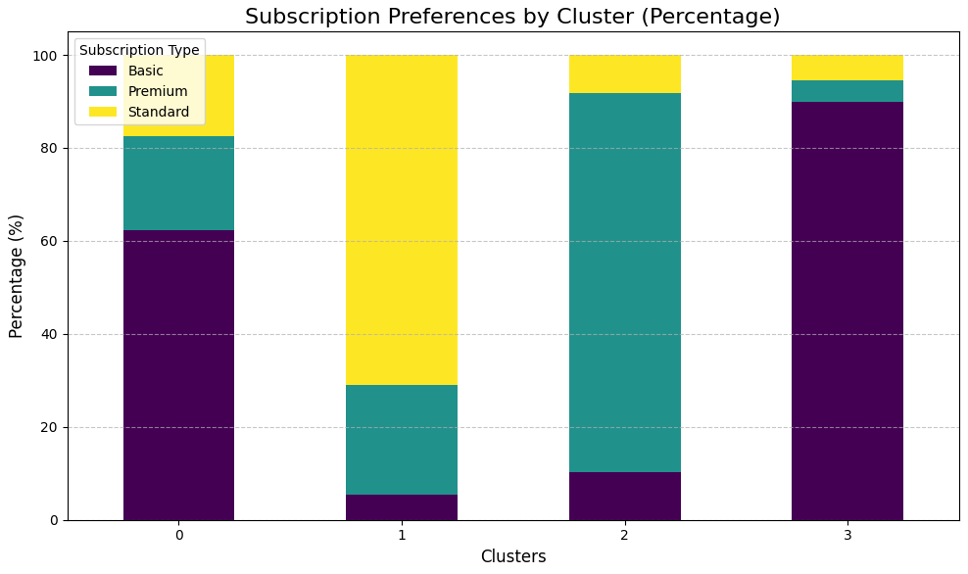
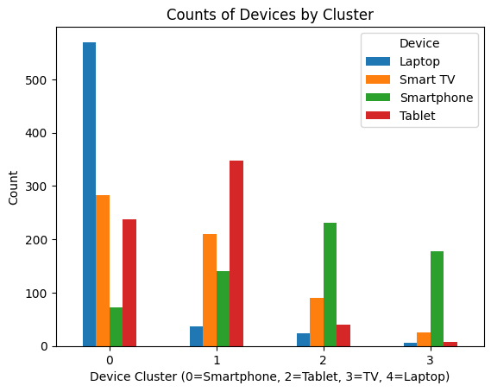
Example visuals of clusters based on features
The bar graph show the percentage of subscriptions by clusters. Cluster 0 and 3 being mostly Basic, Cluster 1 mostly being Standard and Cluster 2 being mostly Premium.
This bar plot is for the count of devices by clusters. Cluster 0 being mainly Laptop users, cluster 1 being mainly Tablet users, cluster 2 being mainly smartphone users, and cluster 3 being mostly smartphone users.

Slide 7
Explanation of Results
Model Performance:
Clustered users using well-separated clusters with clear feature patterns.
The clusters grouped users in a manner that makes sense and can be easily understood which allows for improved decision making.
Without being excessively complex, the clustering process successfully represented the range of user preferences.
Insights for recommendation system:
Each group receives personalized recommendations from the recommendation system by using the cluster information.
Business Impact (discussed in more detail in the last slide)
Customer retention
Improved customer experience
Higher Profits

Slide 8
Recommendation System
Personalized recommendation based on content preferences for users within the same clusters.
Examples of content preferences used in the recommendation system:
Laptop users with Basic subscription (Cluster 0): Flexible range of durations of content that are popular and have broader-appeal.
Tablet users with Standard subscription (Cluster 1): Mix of shorter/longer content that are recent and moderately popular.
Smart TV and Smartphone users with Premium subscription (Cluster 2): Content that is either short or long, with users getting access to newer and high-quality content.
Smartphone users and Basic subscription (Cluster 3): Shorter movies/TV shows that are popular and have broader-appeal.
Others:
Country: Users are more likely to be recommended content from their country as well as their clusters.

Slide 9
Business Value
The success of this recommendation algorithm provides tangible benefits for Netflix such as:
Improved user experience: This personalized recommendation system will increase users’ watch time and content interaction due to better recommendation. Users will spend less time searching for content due to personalized and more accurate recommendations, leading to improved customer experience and higher revenue overtime.
User Retention: Users will be recommended content that is tailored to their preferences which will help in customer retention while also reducing customer churn. This will lead to higher profits by retaining revenue from existing customers while also recovering lost revenue from customer churn.
Growth Opportunities: Netflix can use the recommendation system to target users in different clusters for effective marketing campaigns. Marketing campaigns for specific user groups will lead to potential subscription upgrades, therefore generating increased revenue.
Overall, This recommendation system will be valuable to Netflix due to improved recommendation accuracy, saved searching time, improving customer experience, retaining customers and most importantly generating revenue and profits.

